Slide 1
Spring 2017 CSE 5911
Strategic Operations Center
Cyriac Domini, Daniel Bedich, Shantanu Bhardwaj, Asanka Nanayakkara

Slide 2
NetJets Flight Dashboard
Project Name: Strategic Operation Center
Point of Contact
Umesh Vaswani
Software Architect at NetJets
Perumal Ramasamy
Professor and VP at NetJets

Slide 3
Problem Statement
“Our organization has hundreds of flights that are flown each day. We would like to build an application that is a dashboard of our critical flights, with ability to identify critical issues. And this tool shall have the ability for the SOC members to communicate among themselves to resolve critical issues. The application shall have the following features:”
a. Publish /subscribe functionality so that as the data changes, user’s screens are updated immediately. b. Tracking communication among SOC members and associating communications with key entities c. Dashboard for flights to identify critical issues d. Ability to search past communications

Slide 4
Problem Statement
Create a dashboard that displays flights with critical issues and their possible backups and has real time view updates.

Slide 5
In Scope
Adding/Removing flights and their recovery options
Filtering/Searching flights
Automatic update functionality
Chat
User based
Entity based (Flight/Problem)
User actions
User authentication

Slide 6
Out of Scope
Integration with NetJets databases
Active directory group sign in (SSO)
Searchable chat
Customized dashboard views for different roles

Slide 7
Key Deliverables
Architecture Diagram
Finished Application with the following:
Login Page with proper functionality
Sample flights page with appropriate information
Working Chat
Documentation
User guide
Code detail
Final Presentation
Poster

Slide 8
Assumptions
Continued weekly meetings with developers and sponsor
Continued commitment from team
Working development tools

Slide 9

Resources
Angular.io documentation
Stack Overflow
Lynda
Michael Hartl’s Ruby on Rails Tutorial
Sponsor

Slide 10
Risks
Running out of time
Changing of requirements
Learning curve for socket programming with Rails 5
Choosing the right architecture
Choosing an ideal testing methodology/software suite for integration, user, and unit testing

Slide 11
Issues/Constraints
Integrating Angular2 with a Rails backend in real time
Scheduling conflicts
Time
Very limited access to old dashboard

Slide 12
Dependencies
Auto UI updates
Rails 5 with ActionCable (websocket implementation)
Dashboard
jQuery Datatables
Ruby Gems
Devise, Json rails
Integratable Chat App
OS/Software
Ubuntu 16.04 (or any UNIX based OS) with terminal and text editor
Rails 5
Puma server for serving app locally
Ruby jUnit Testing framework (in progress…)
Front end testing framework (in progress…)

Slide 13
Open Questions?
Chat groups?
Embedded or pop-out chat?
Chat logs?
Stylistic UI decisions?

Slide 14
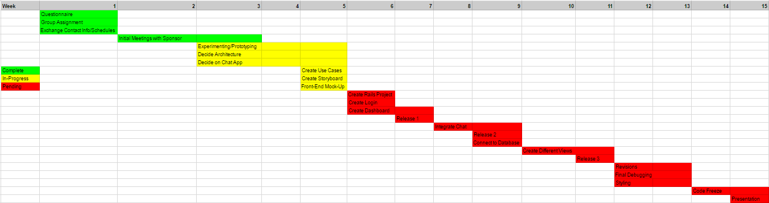
High-Level Plan

Slide 15
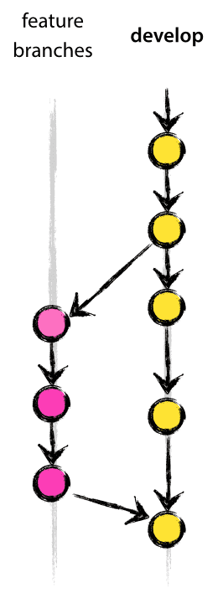
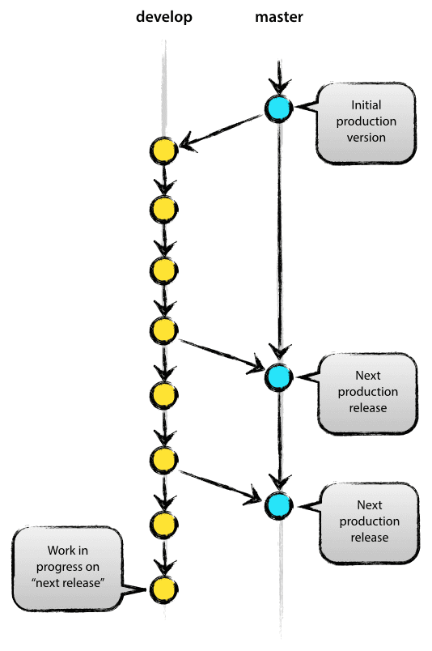
Project Management Methodology
Visual Studio Team Services
Git version control
Strict branching strategies
Agile
Frequent collaboration between team members
Test Driven Development
Detailed documentation

Slide 16
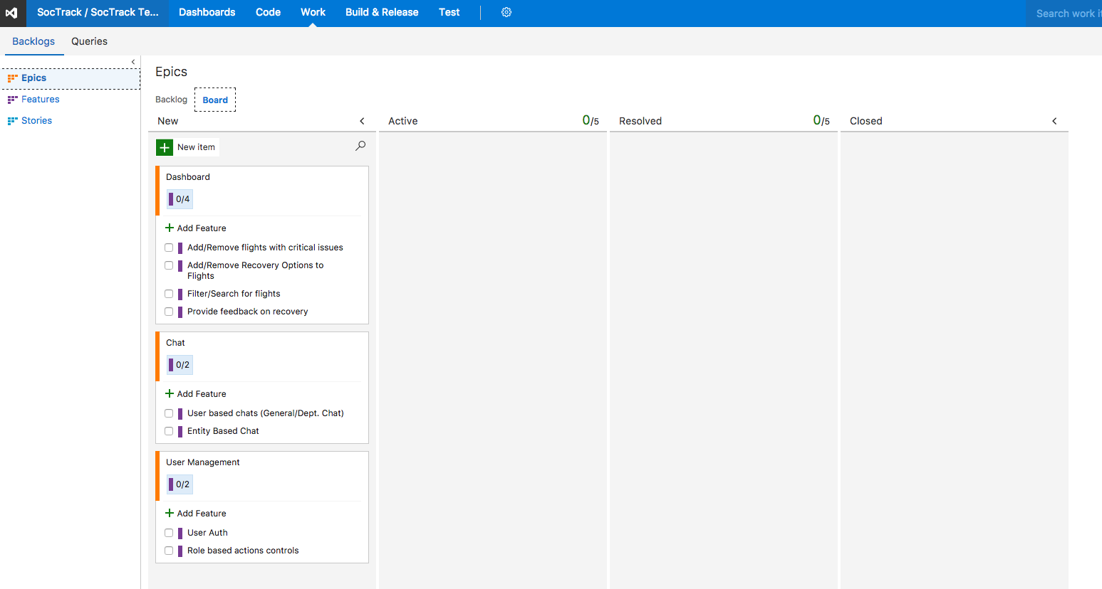

Slide 17
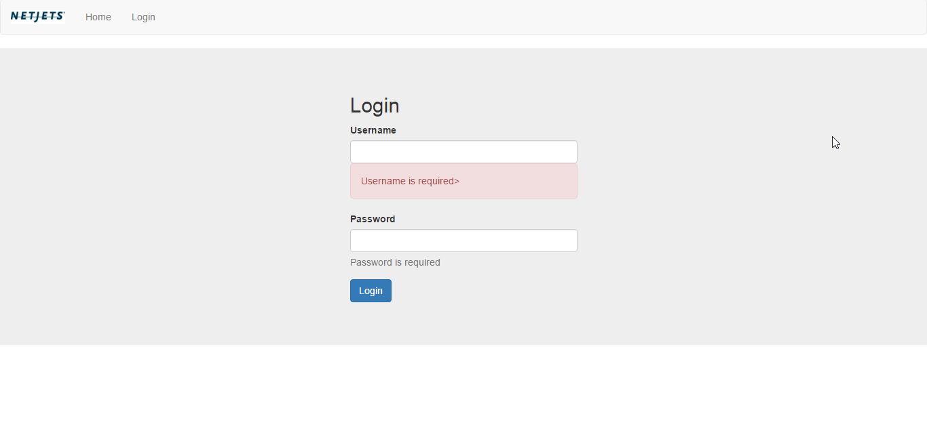
Mock-Ups

Slide 18
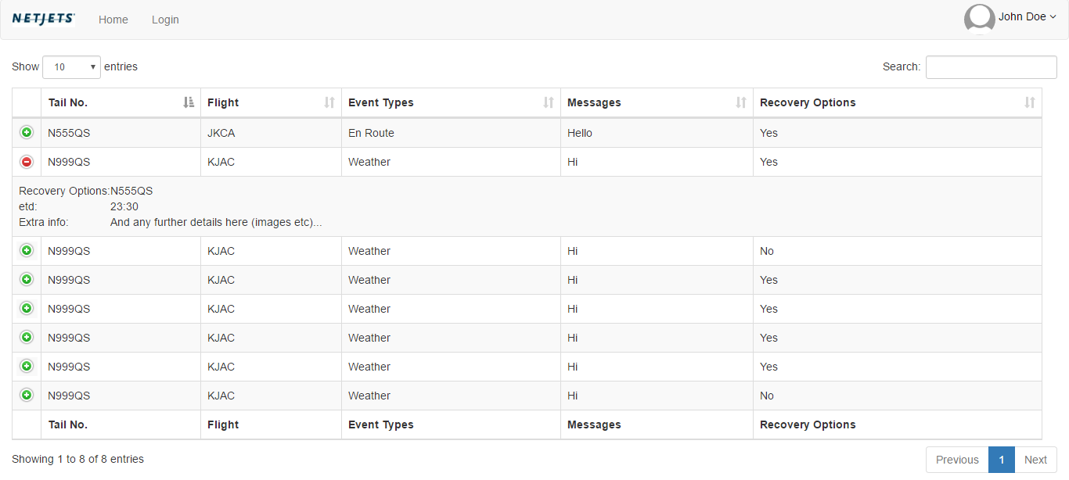

Slide 19
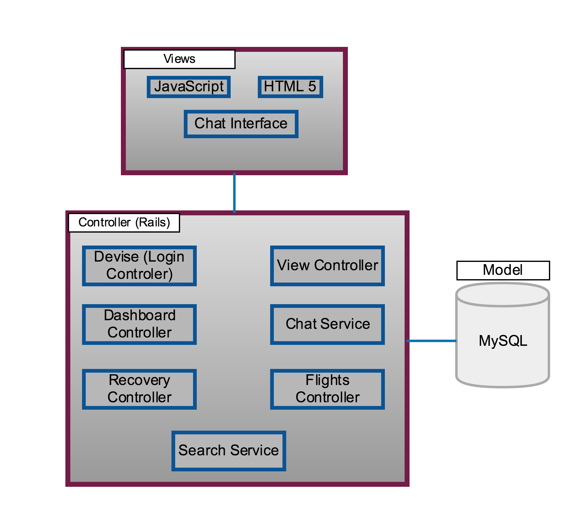
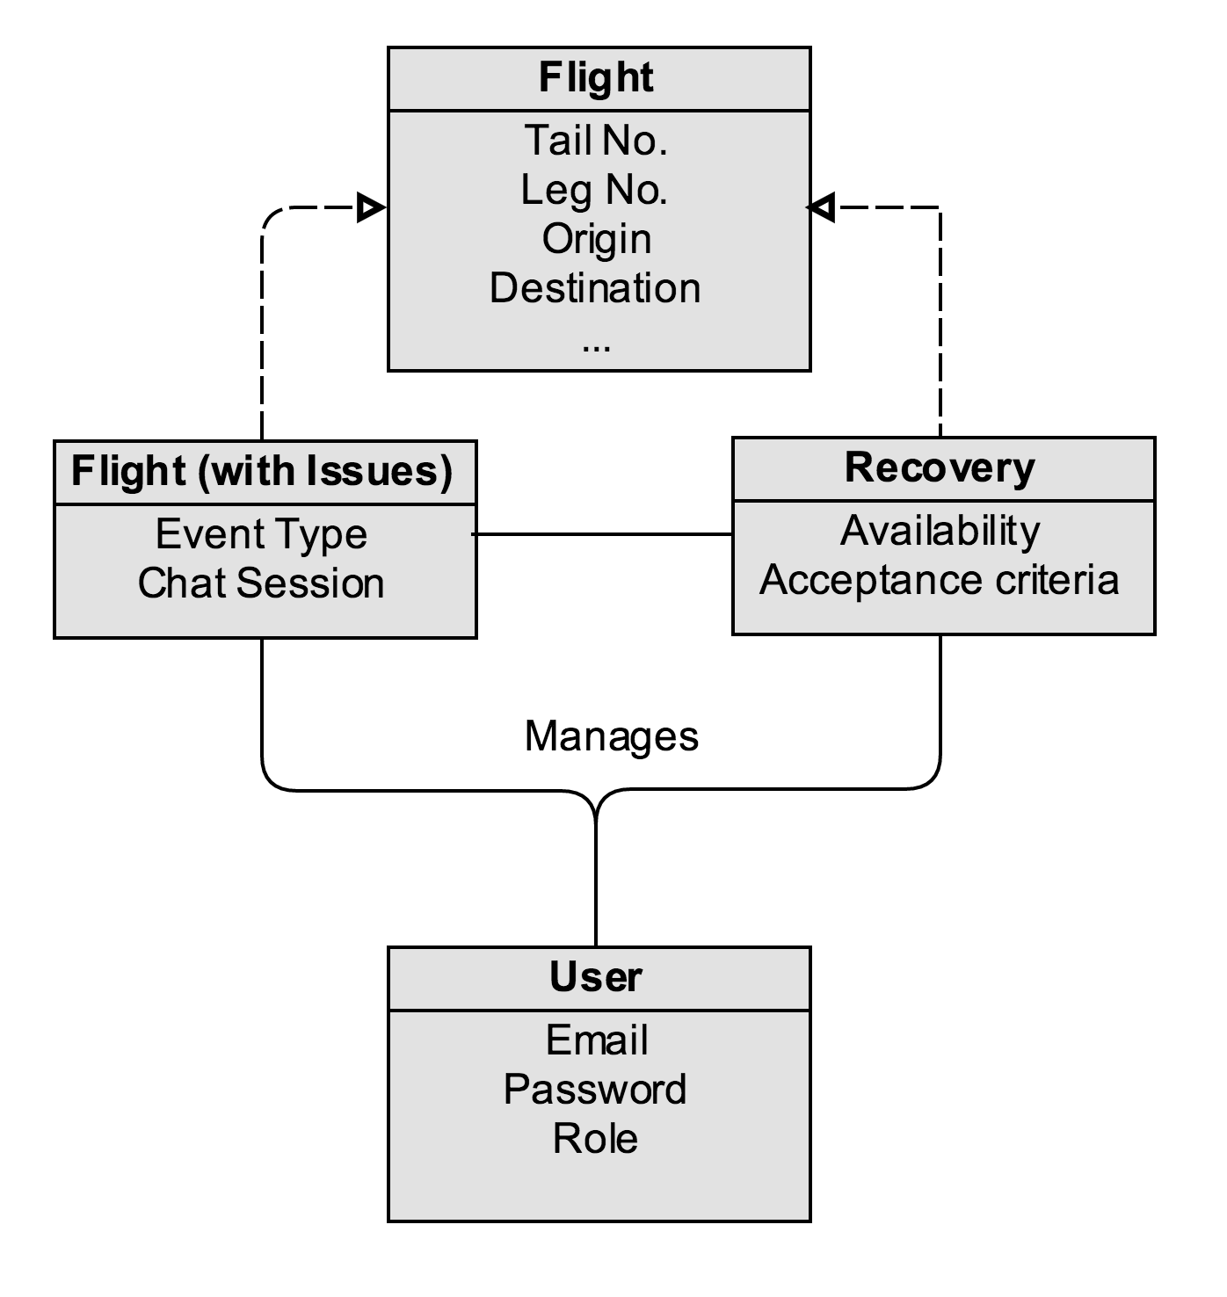
Architecture

Slide 20
Questions?

